Slide 1


Introduction to
Robotic Process Automation
COMMUNITY
HALL RESERVATION SYSTEM
220701116
Kalaiselvi S
Mrs. J. Jinu Sophia
Assistant Professor(SG)

Slide 2
Abstract
This project focuses on automating the Community Hall Reservation System using Robotic Process Automation (RPA) with UiPath. The system simplifies the process of booking community halls by leveraging automation for user authentication, time slot verification, and email communication. User inputs, such as name, phone number, email, and address, are collected through input dialogs, and an OTP is sent via email for verification. After successful authentication, the system validates the user’s selected time slot from an Excel sheet, updates the booking status, and sends a confirmation email with booking details and payment instructions. By automating repetitive tasks, the project reduces manual effort and enhances efficiency.

Slide 3
Need for the Proposed System
Manually managing community hall reservations is a time-consuming and error-prone task, especially for large-scale events or high-demand venues. The proposed system addresses these challenges by automating the reservation process, ensuring accuracy, efficiency, and a seamless user experience. It eliminates the need for manual data entry, verification, and communication, reducing errors such as double bookings or missed notifications. Additionally, the system can handle large volumes of bookings dynamically, making it ideal for venues with frequent reservations. By leveraging RPA, this solution saves time, enhances operational efficiency, and ensures a more reliable and user-friendly reservation process.

Slide 4
Advantages of the Proposed System
Time Efficiency: Automates repetitive tasks like slot verification, OTP authentication, and email notifications, reducing time spent on manual processes.
Accuracy and Consistency: Ensures precise booking updates and eliminates errors in data entry or communication.
Scalability: Handles multiple bookings efficiently, making it suitable for high-demand scenarios.
Cost-Effective: Reduces dependency on manual labor, minimizing operational expenses.
User-Friendly: Provides a seamless experience with minimal input, autonomously handling tasks like authentication and notifications

Slide 5
Literature Survey
Title: Automating Community Hall Reservation System Using RPA Advantages:
Automates booking and status updates, reducing manual errors.
Increases efficiency with seamless email communication. Disadvantages:
Setup can be time-consuming for form and email configuration.
Title: RPA-Driven Fitness Reminder System Advantages:
Ensures consistent fitness reminders with automated scheduling.
Scalable and customizable for various routines. Disadvantages:
Relies on accurate time synchronization and data updates.

Slide 6
Main Objective
The primary objective of the proposed system is to automate the Community Hall Reservation process by integrating user inputs, OTP verification, and time slot management. The system aims to streamline the booking process, ensuring accuracy, efficiency, and timely notifications while eliminating manual interventions. This automation is designed to handle multiple reservations seamlessly, providing users with confirmation emails and payment reminders, thereby enhancing user experience and operational efficiency.

Slide 7
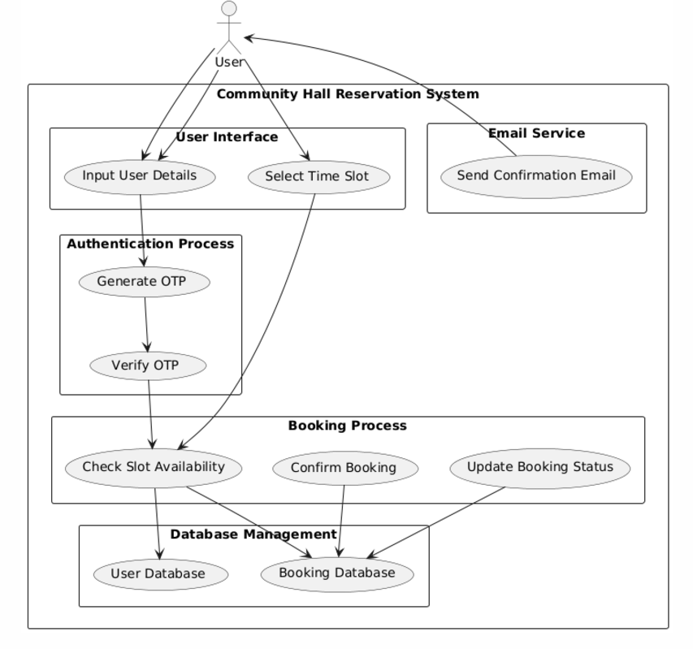
Architecture

Slide 8
System Requirements
Hardware
Processor:Minimun Intel i5
RAM:Minimum 8GB
Storage:Minimum 20 GB for UiPath installation and certificate files.
Software
Operating System:Windows 10 or higher
UiPath Studio:Community or Enterprise Edition(Latest version)
Microsoft Office:Microsoft Excel and Microsoft Outlook
SMTP Server: For OTP and confirmation email sending.

Slide 9
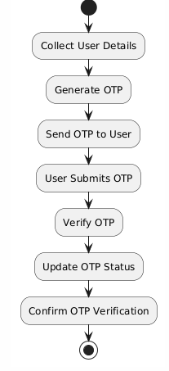
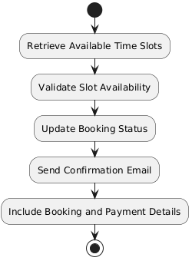
Functional Description
Module 1: User Data Collection
Collects user details (name, phone, email, address) and verifies them via OTP. Once validated, the data is confirmed for accuracy.
Module 2: Booking Process and Confirmation
Retrieves available time slots, checks availability, and updates the booking status. A confirmation email with booking and payment details is then sent.

Slide 10
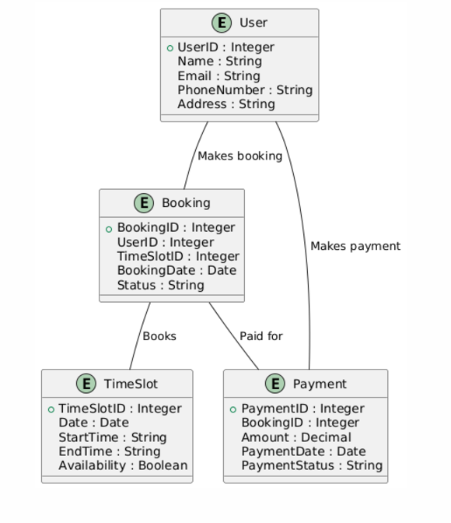
Table Design
Entity Relationship Diagram

Slide 11
Process Design
Main Process: Community Hall Booking Automation Start Process: User triggers the booking automation via the system interface.
Collect User Data:
Input User Details: The bot collects user inputs such as name, phone no, email, and address.
OTP Generation: An OTP is generated and sent to the user's email for verification.
Authenticate User:
OTP Verification: The bot verifies the OTP entered by the user against the sent OTP.
Confirmation: If the OTP is correct, the user is authenticated.
Retrieve Available Time Slots:
Access Excel File: The bot reads the available time slots from an Excel file.
Validate Slot: The bot checks the user’s selected time slot to ensure availability.
Confirm Booking:
Update Status: If the slot is available, the bot updates the booking status in the Excel sheet.
Send Confirmation Email: The bot sends an confirmation email booking and payment details.
End Process: The system completes the process after sending the confirmation email.

Slide 12
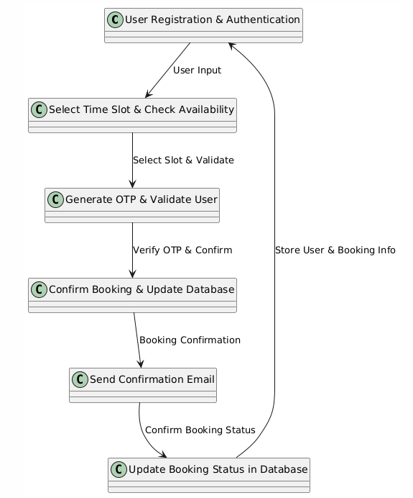
Process Design

Slide 13
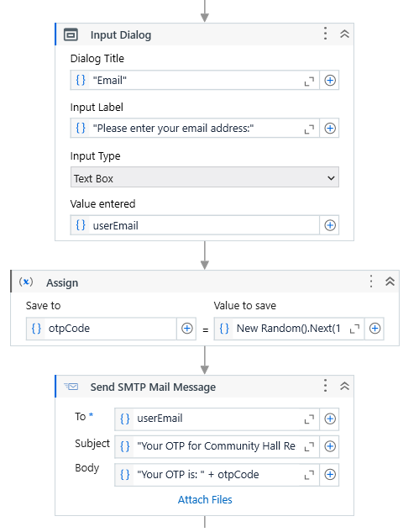
Implementation
Module 1 captures user data (name, phone number, email, and address) from the system interface. It then generates an OTP and sends it to the user’s email for verification. The system waits for the user to input the OTP, and upon successful verification, the data is validated for completeness. The valid entries are stored in a DataTable, and this information is passed on to Module 2 for the next step in the booking process

Slide 14
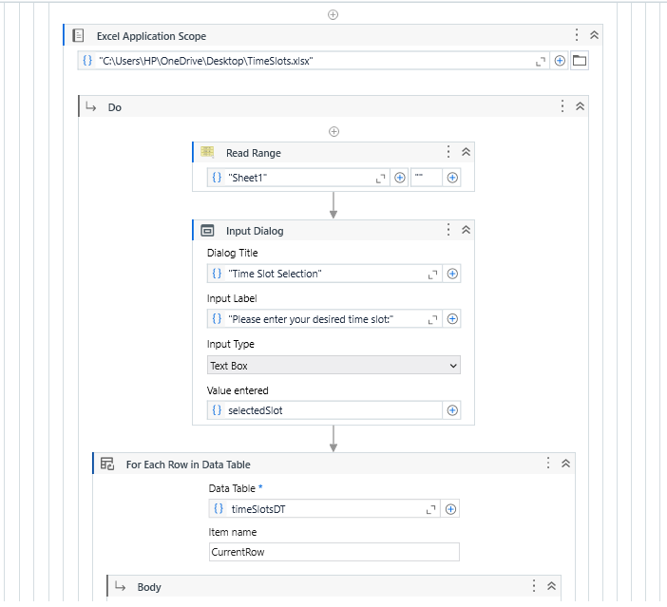
Implementation
Module 2 retrieves available time slots from an Excel file and compares the user's chosen time slot to ensure availability. If the slot is available, the booking status is updated in the system, and a confirmation email containing the booking and payment details is sent to the user. This process ensures that the user is confirmed and all the necessary updates are made in real-time.

Slide 15
Testing
Testing for the Community Hall Booking System focuses on ensuring the correct functionality of both user data collection (Module 1) and the booking process (Module 2). In Module 1, tests are performed to verify that user details (name, phone, email, address) are accurately captured and validated through OTP verification. For Module 2, tests focus on verifying that available time slots are correctly retrieved, validated for availability, and that booking statuses are updated accordingly. The system is tested for scalability by simulating multiple users and ensuring it handles concurrent requests correctly. Edge cases, such as selecting unavailable slots or entering invalid data, are tested to confirm that appropriate error messages and logging mechanisms are in place

Slide 16
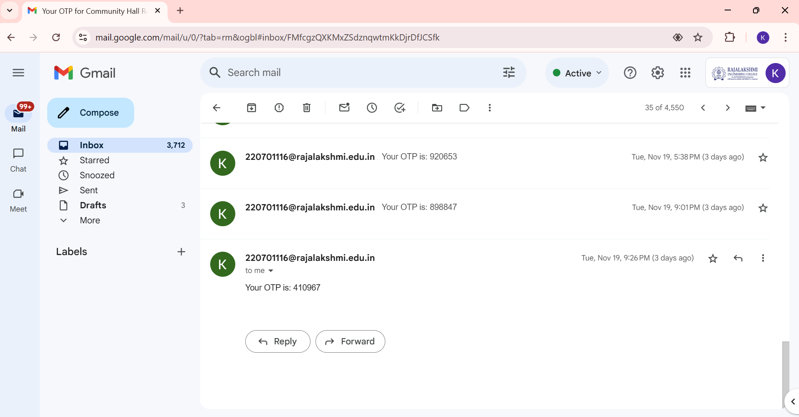
Testing
OTP FOR VERIFICATION

Slide 17
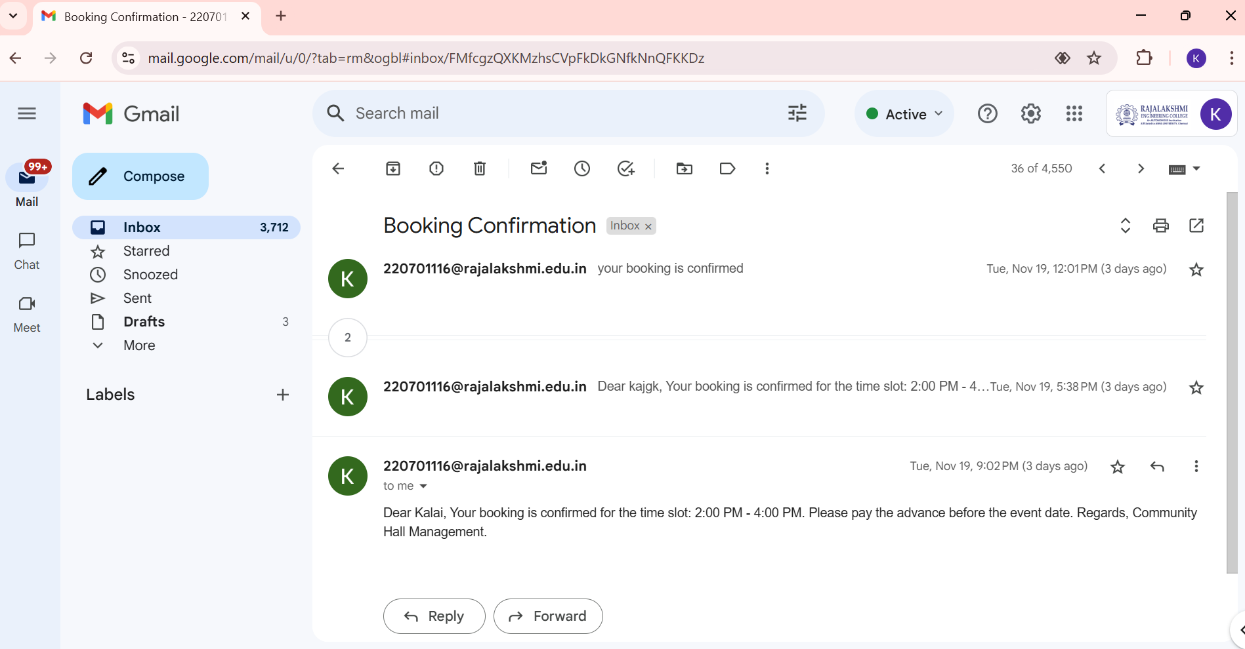
Testing
BOOKING CONFIRMATION EMAIL

Slide 18
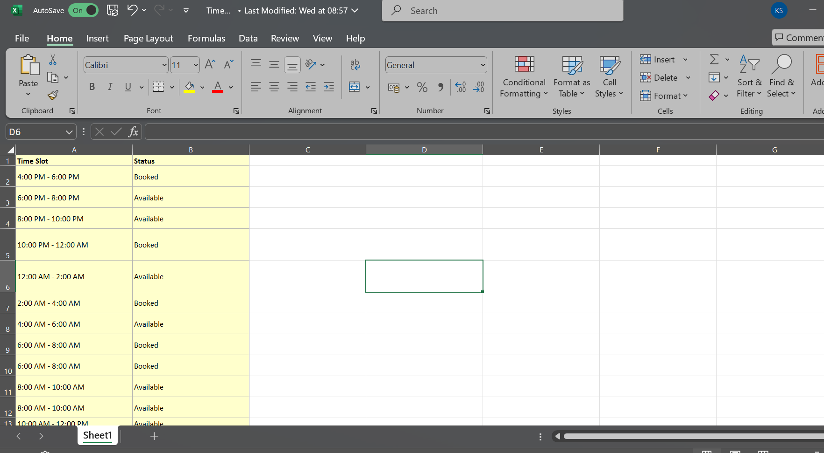
Testing
BOOKING DETAILS LOG

Slide 19
Conclusions
In conclusion, the Community Hall Reservation System successfully automates the process of booking and managing reservations. By leveraging Robotic Process Automation (RPA) with UiPath, the system streamlines user authentication, time slot validation, and confirmation notifications. This automation reduces manual intervention, eliminates errors, and ensures timely communication. The modular design of the system allows for easy scalability and future enhancements. The solution significantly improves efficiency and user experience, making it ideal for handling high-volume bookings while ensuring accuracy and consistency. The integration of RPA ensures a seamless, automated, and reliable booking process.

Slide 20
Future Enhancement
Multiple Payment Gateway Integration: Support various payment methods like PayPal, credit cards, and bank transfers.
SMS Notifications: Send booking confirmations and reminders via SMS.
Calendar Integration: Sync bookings with Google Calendar or Outlook for easy tracking.
Admin Dashboard: Provide an overview of bookings, cancellations, and payment statuses for better management.
User Review System: Allow users to give feedback, improving service quality.
Mobile App: Develop a mobile app for easy reservation management on the go.

Slide 21
IEEE Paper
Title:Advanced reservation system.
Authors: M. Murin; F. Jakab; Miroslav Michalko
This paper explores the development of a reservation system aimed at automating booking processes, improving efficiency, and providing a user-friendly interface for real-time slot management. It discusses integration with databases for time slot verification and notification systems.
Title:Design and Development of an Integrated Room Reservation System for Higher Education Institutions
Authors: Josephine D. German; Dave Cullen G. Yap; Guiller O. Binoya
This study focuses on creating a reservation system tailored for room bookings in educational settings. It integrates user authentication, booking validations, and automated notifications. Although specific to education, its concepts are applicable to hall booking systems. Authors: Not explicitly mentioned.

Slide 22
References
Maria Johnsen, Ahmed Raza. "Design and Implementation of Online Reservation Systems"
Rakesh Kumar, Seema Patel "A Survey on Online Booking Systems: Usability and Scalability Challenges"
Steven Bradley, Priyanka Sharma . "Automation in Reservation Systems Using AI and ML"

Slide 23
Queries

Slide 24
Demonstration

Slide 25
Thank You

